Slide 1


INSIGHTS INTO HOUSING MARKETS IN HO CHI MINH CITY
Students: Vo Thanh An
Nguyen Hoang Phuc Huy
Advisor: Dr. Nguyen Van Vu

Slide 2
Outline
Introduction, Motivation and Objective
Approach
Result
Conclusion and Future Work

Slide 3
Introduction

Slide 4
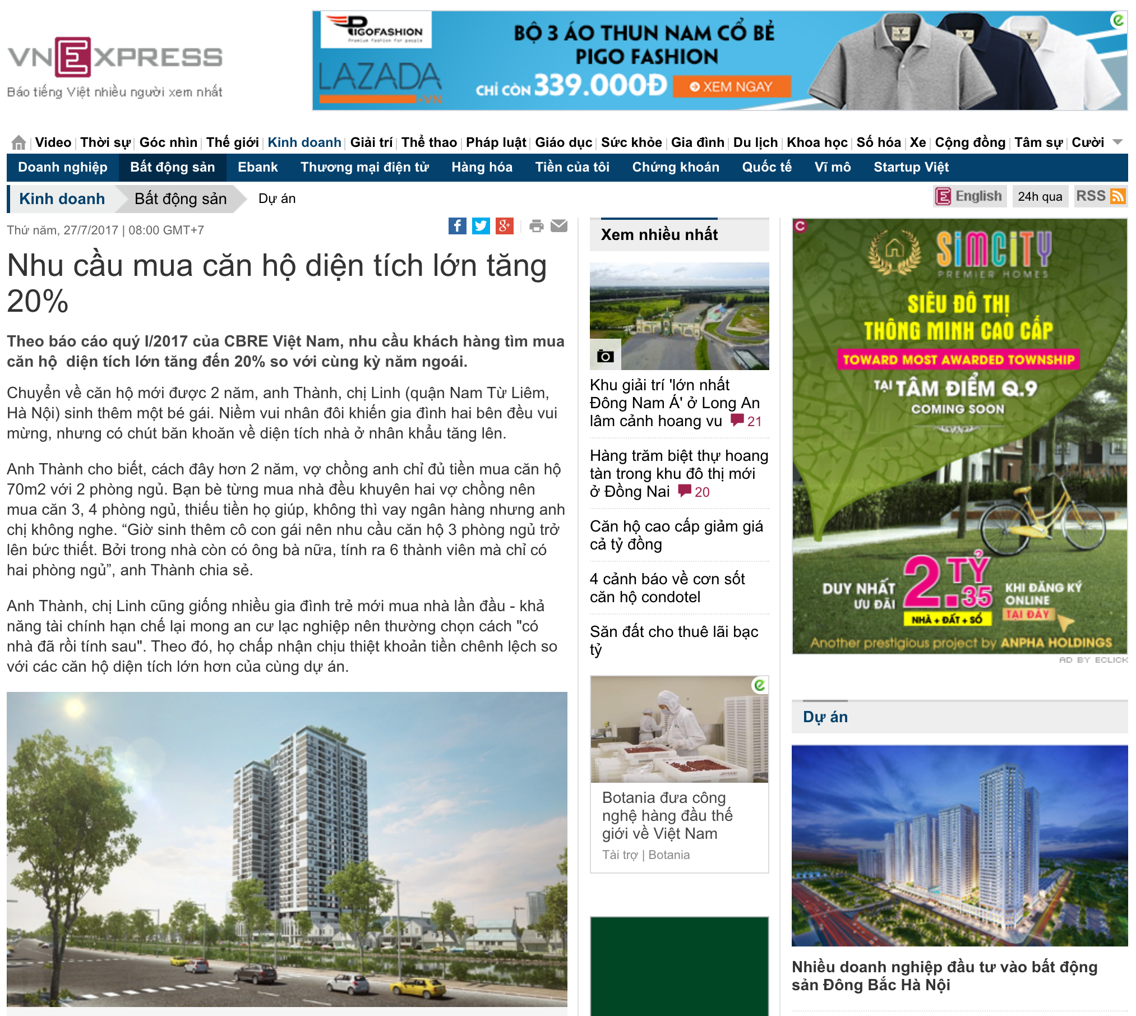

Introduction
Investment channels such as gold and U.S dollars are less reliable
Real estate market has become a hot topic.
Notes:
As traditional investment channels such as gold and U.S. dollars become less reliable, investors in the southern metropolis have begun directing their resources toward the realty sector.

Slide 5
Ho Chi Minh Real Estate Market Overview

Slide 6
Motivation

Slide 7
Objective
A system that:
1. Automatically collect real estate data from various resources
2. Analyze data and provide an insight about the housing market in real-time

Slide 8
Approach
Data Crawling
Data Cleaning
Data Visualization

Slide 9

Data Crawling
Scrapy - Python Web Crawling Framework
Dispatcher
Website 1
Website 2
Website 3
Notes:
To gather data for our analysis, we create spiders for several real estate website. Each website is assigned one spider. Their mission is to travel through the page structure and collect all real estate listings’ info available, following certain specification. We choose Scrapy, a very popular framework in web scraping due to its simplicity and robustness, to develop our spider.

Slide 10

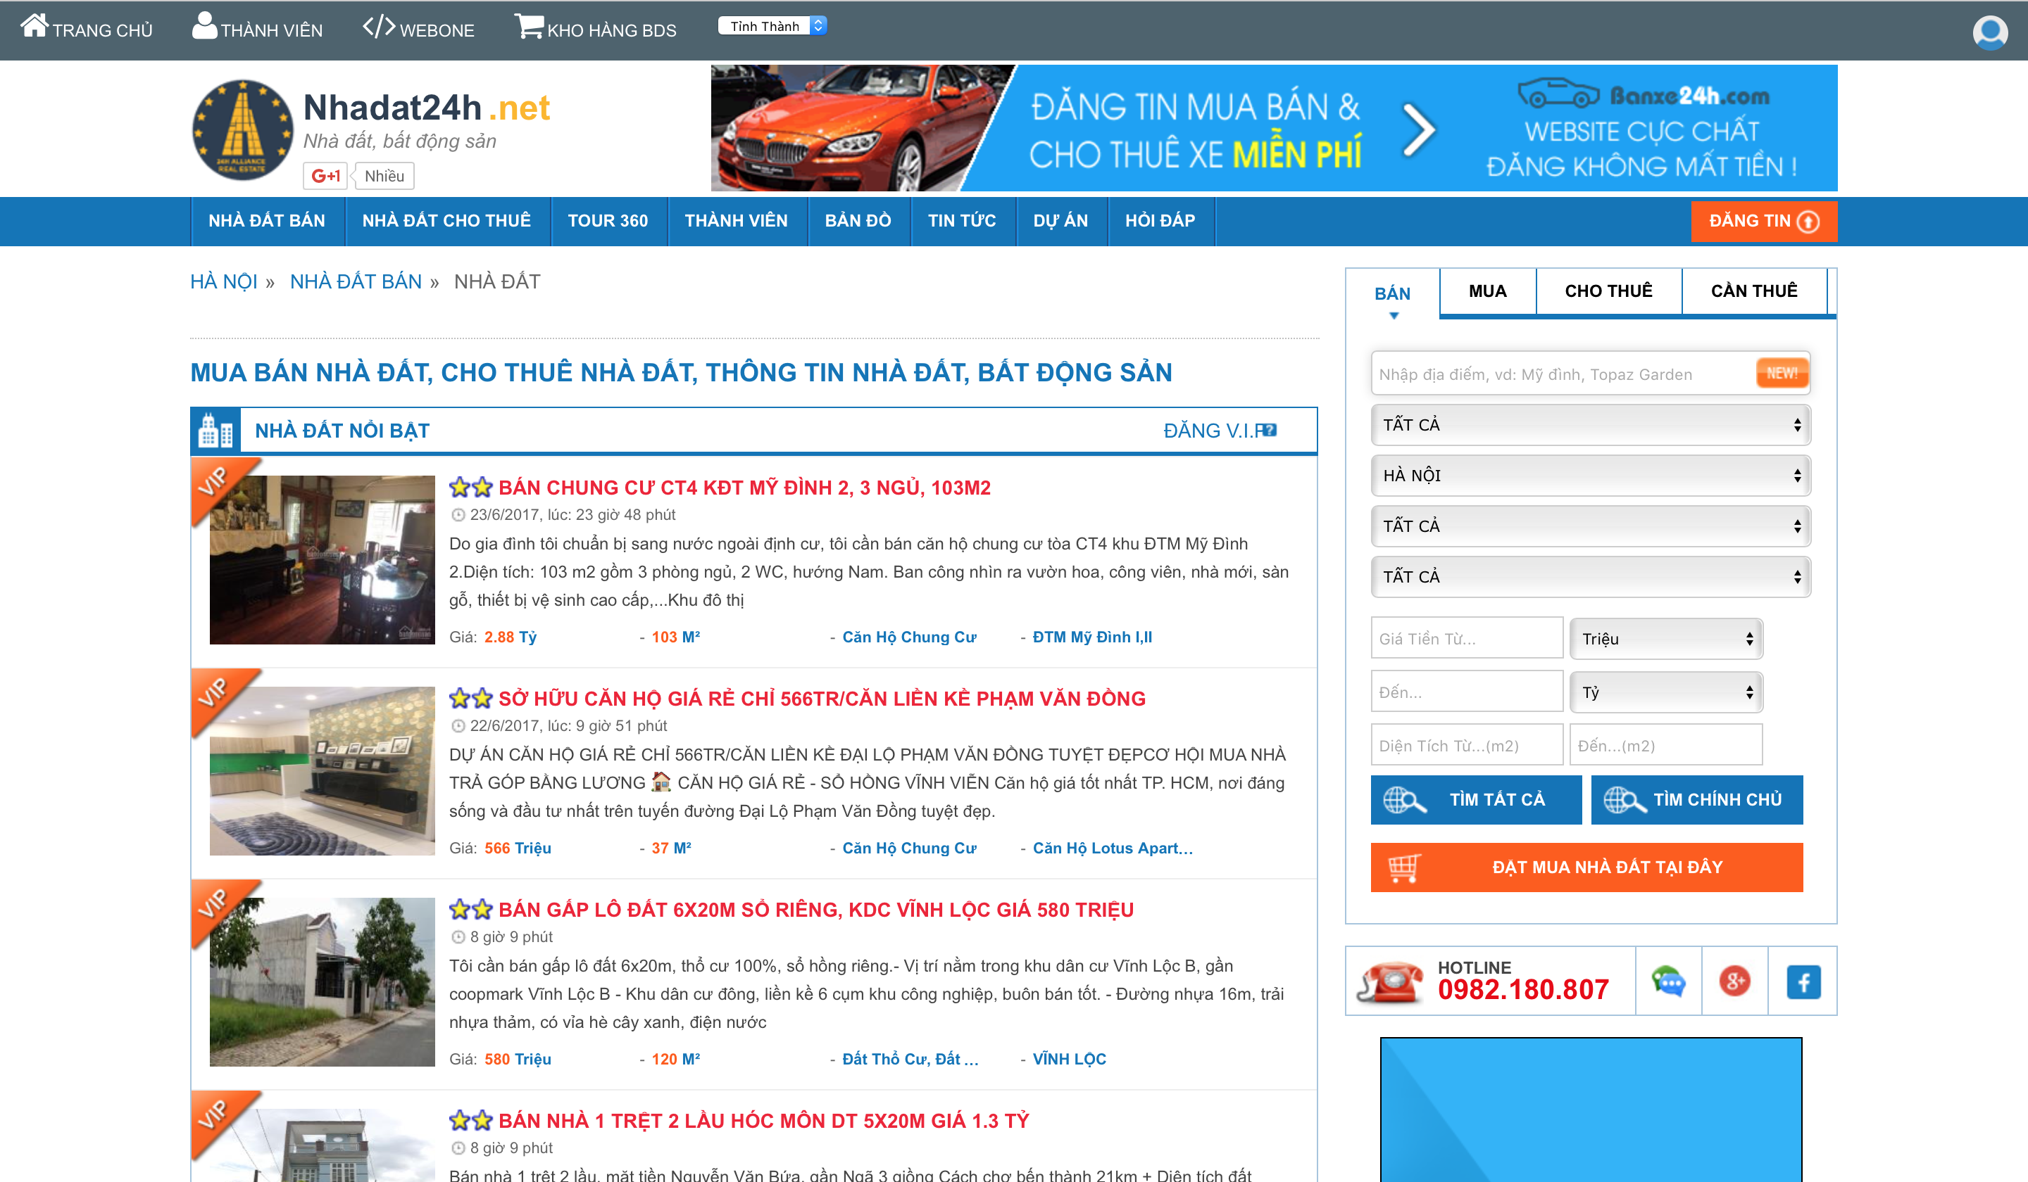
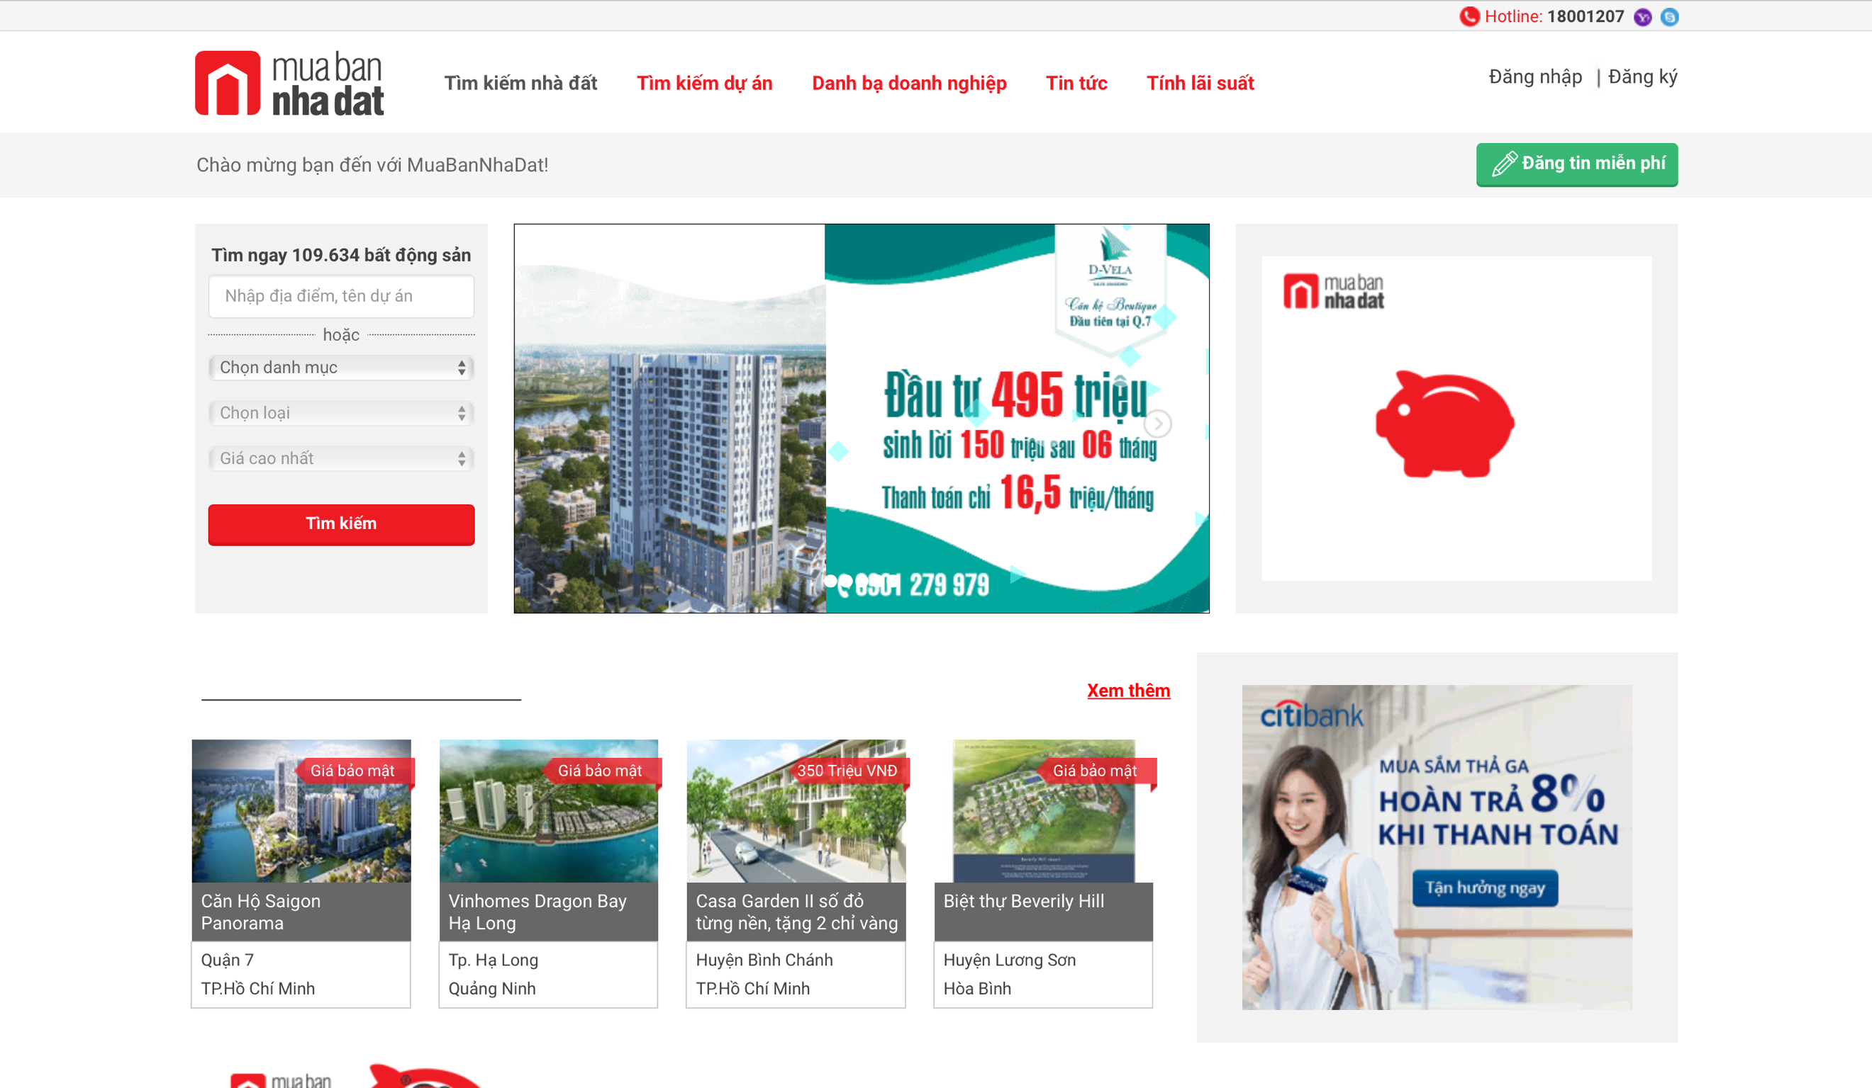
Data Crawling
Real Estate Websites for Data Crawling:
www.muabannhadat.vn
www.alonhadat.vn
www.nhadat24h.net
www.123nhadat.vn
www.batdongsan.com.vn
www.diaoconline.vn

Slide 11
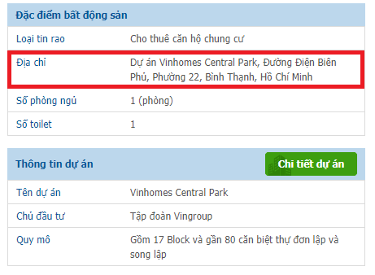
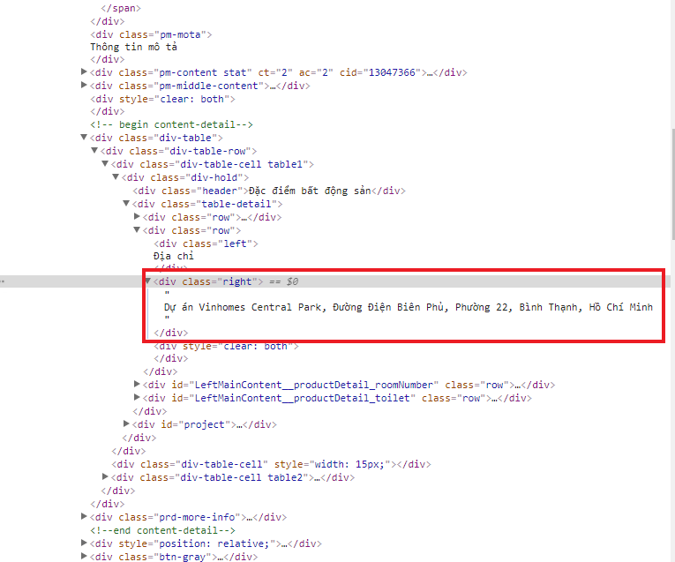
Data Crawling
Notes:
To extract data from a web page, we use XPath (XML path language). It is used to navigate through the HTML structure and lock in to the part in question.

Slide 12
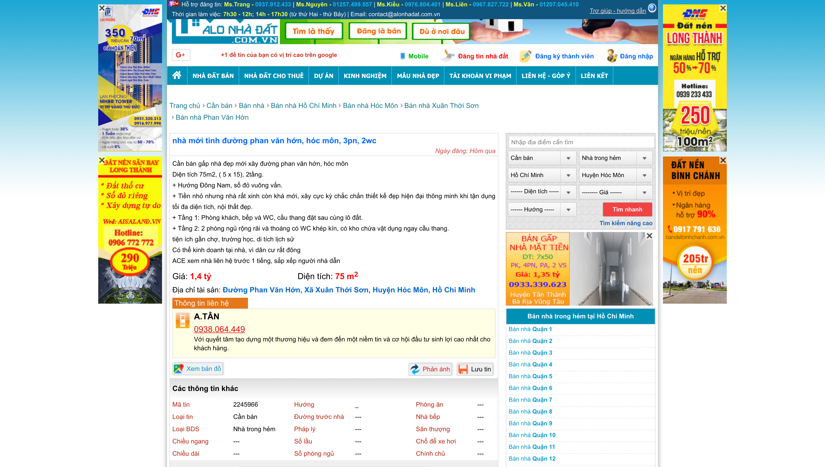
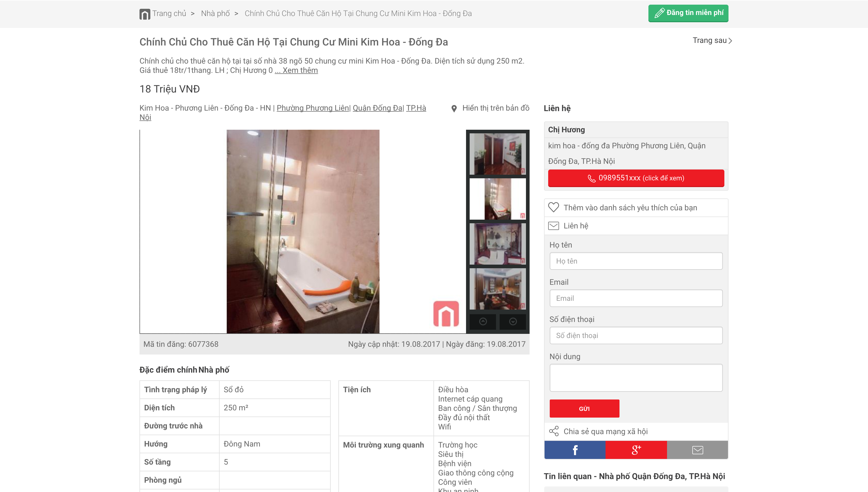
Data Storage Format
ID: post’s ID
Title: post’s title
Location: road, ward, county, city
Author: house’s owner
Post-time: posting time
Project: name of the apartment
Price: price of the house
Transaction-type: sale or rent
House-type: villa, apartment, townhouse …
Description: house discription
Notes:
Using Xpath, we extract several mandatory info to identify a real estate listing, including title, price, area, address, etc.

Slide 13
Merging Data From Multiple Sources
Every website has its own format. Human can read but system cannot.
Ex: Ho Chi Minh (muabannhadat.vn) vs HCM(alonhadat.vn) vs TP Ho Chi Minh(batdongsan.com.vn
Merging Data:
Hotel, Restaurant
Hotel, Motel
Hotel, Restaurant, Motel
Hotel

Slide 14
Data Grouping
Before data cleaning, divide dataset into smaller groups (similar location and house type)
Reasons:
Reduce number of comparisons between real estate listings
Increase accuracy of duplicated listings removal
Increase accuracy of removing listings with unreasonable price

Slide 15
Data Grouping
Root
Rootz
For sale
For rent
Transaction type
Province
Ho Chi Minh
…
…
County
…
Binh Thanh
House type
Apartment
…
[Listing 1, Listing 2, Listing 3, …]

Slide 16
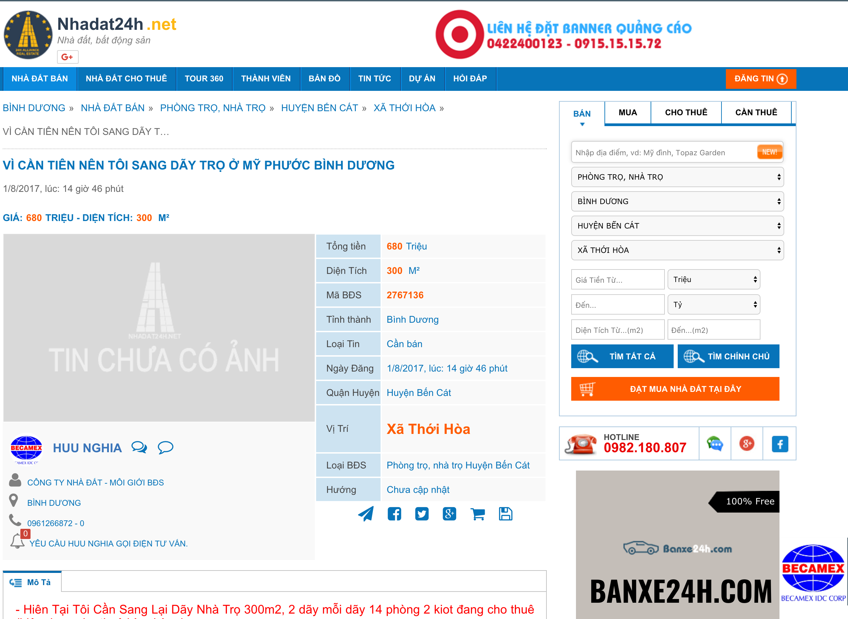
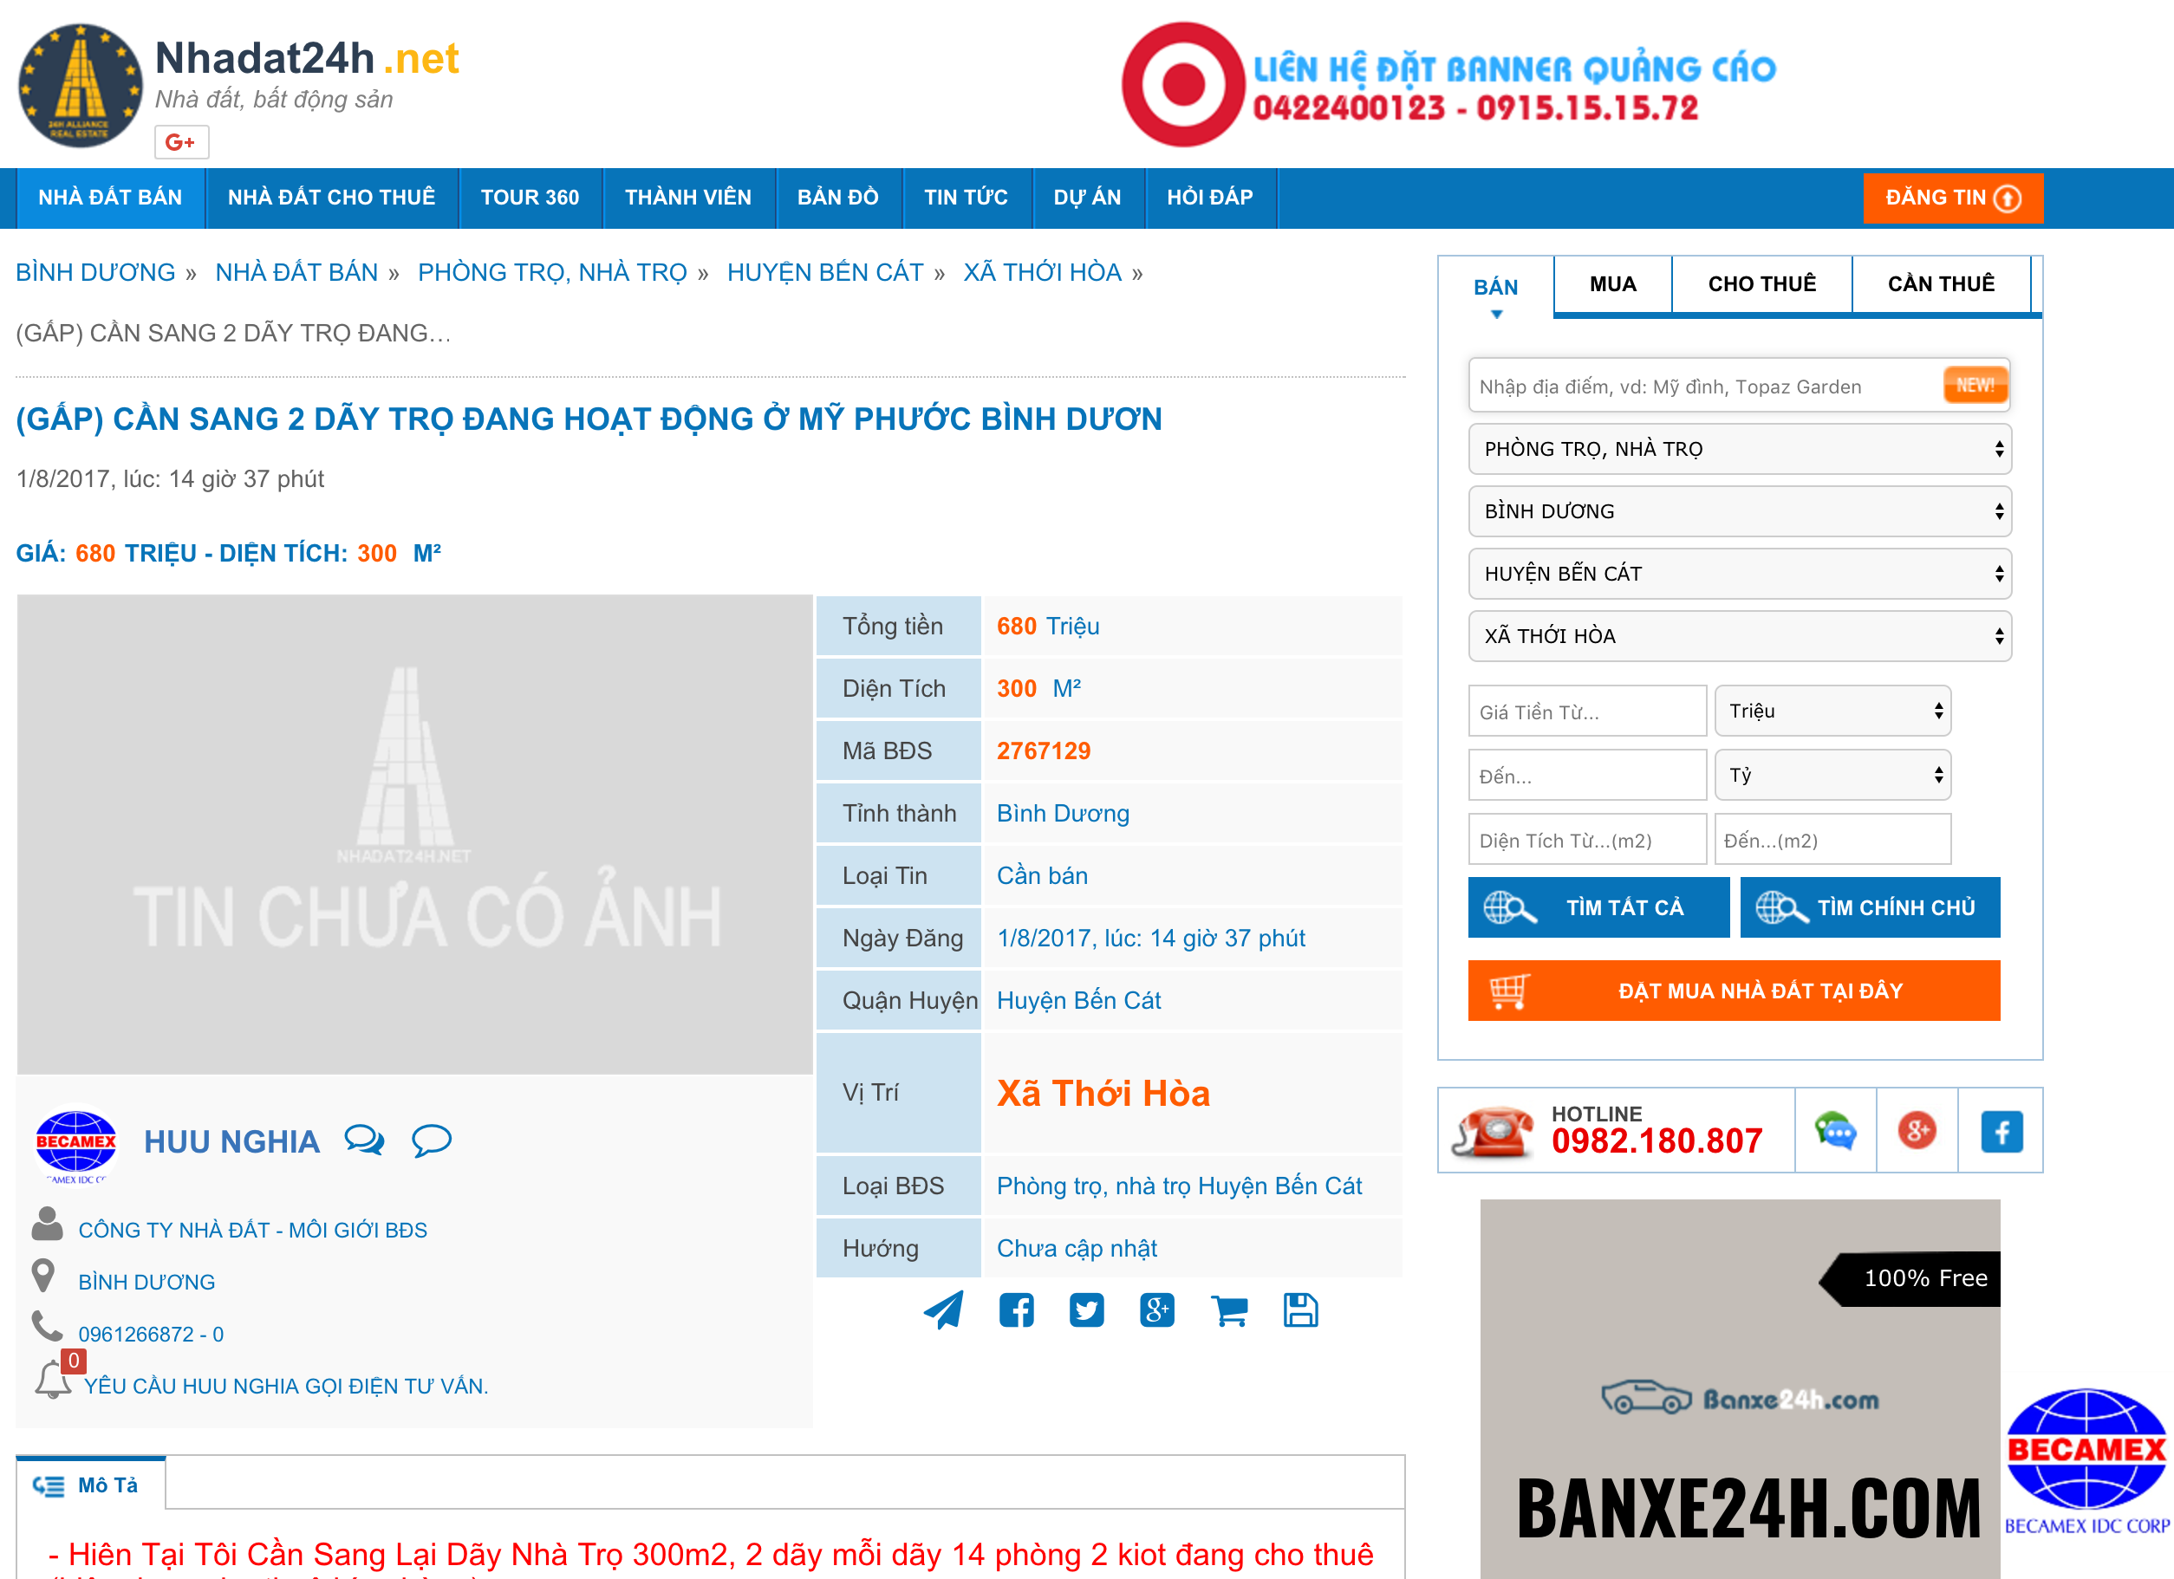
Data Cleaning
Duplicated Housing Listings
Reason: houses’ owners increase the chance that their houses pitching people’s interest.

Slide 17
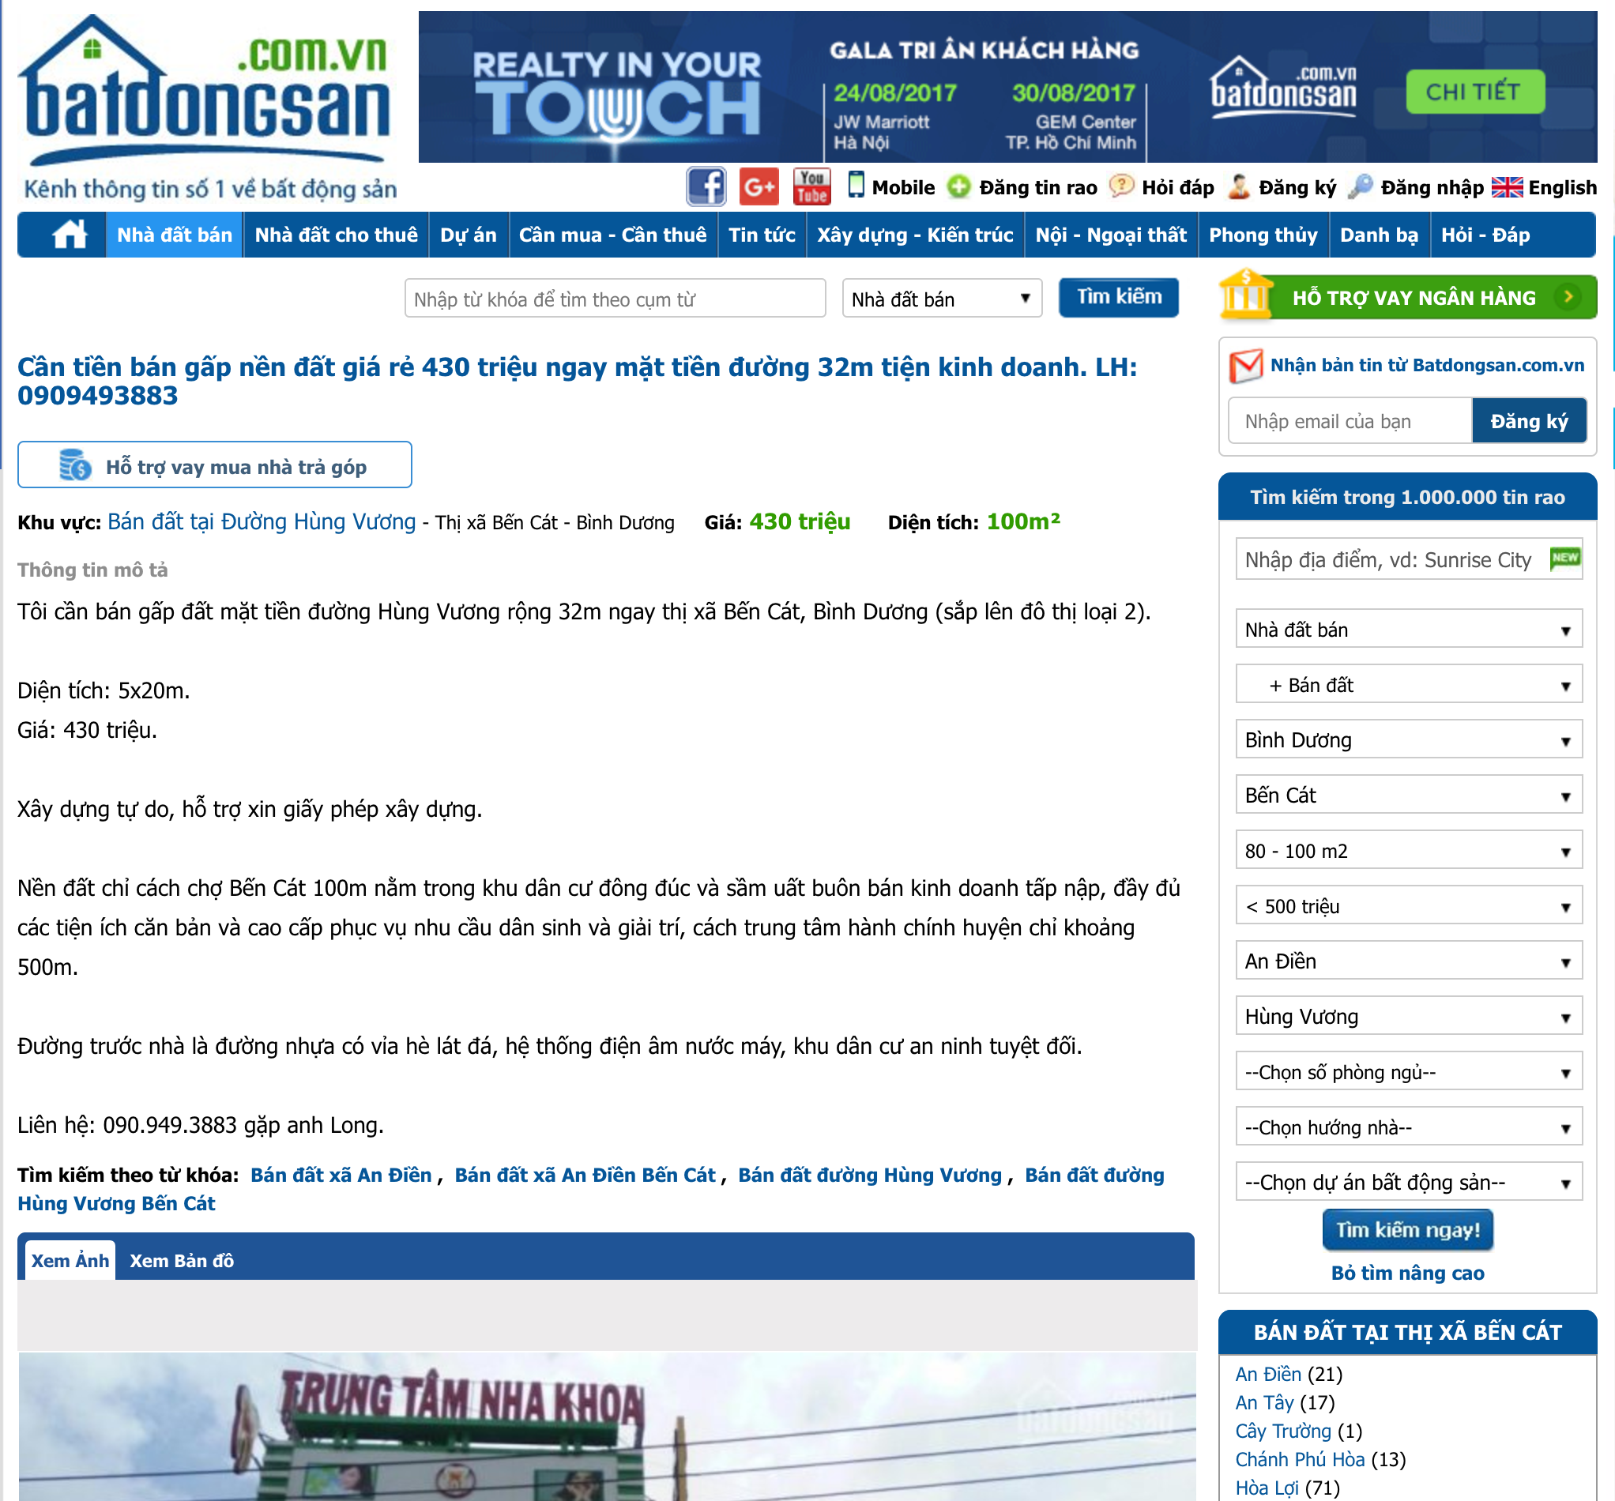

Data Cleaning
Duplicated Housing Listings

Slide 18
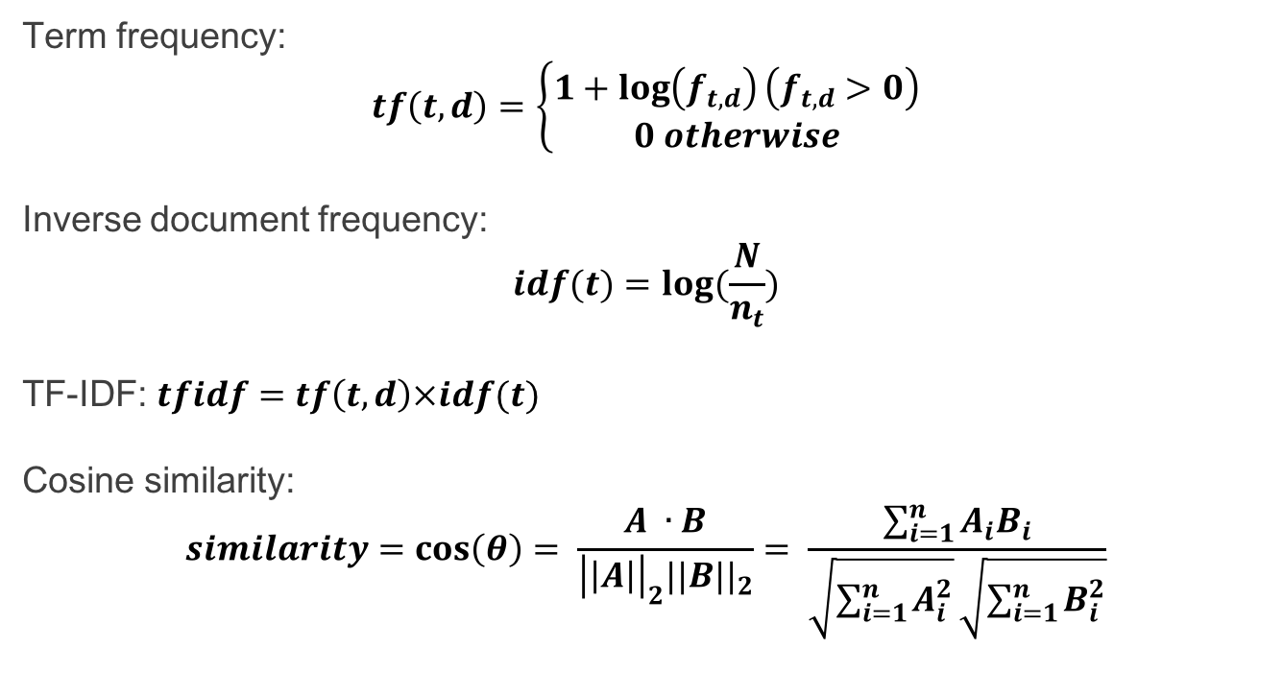
TF-IDF
Term frequency:
$$tf\left(t,d\right)=\left\{\begin{aligned}1+\log\left(f_{t,d}\right)\left(f_{t,d}>0\right) \\ 0 otherwise\end{aligned}\right.$$
Inverse document frequency:
$$idf(t)=log(\frac{N}{n_{t}})$$
TF-IDF: $tfidf=tf\left(t,d\right)×idf(t)$
Cosine similarity:
$$similarity=\cos\left(θ\right)= \frac{A ∙B}{{\left|\left|A\right|\right|}_{2}{||B||}_{2}}= \frac{\sum_{i=1}^{n}{A_{i}B_{i}}}{\sqrt{\sum_{i=1}^{n}{A_{i}^{2}}}\sqrt{\sum_{i=1}^{n}{B_{i}^{2}}}}$$

Slide 19
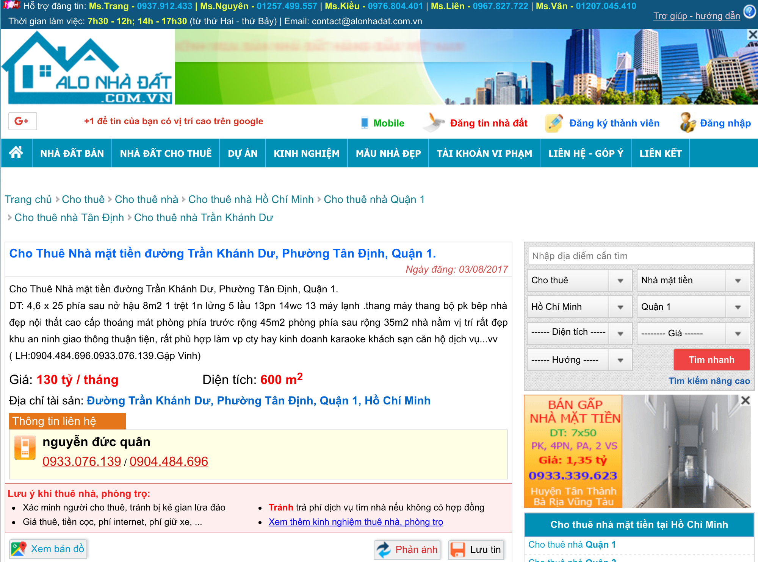
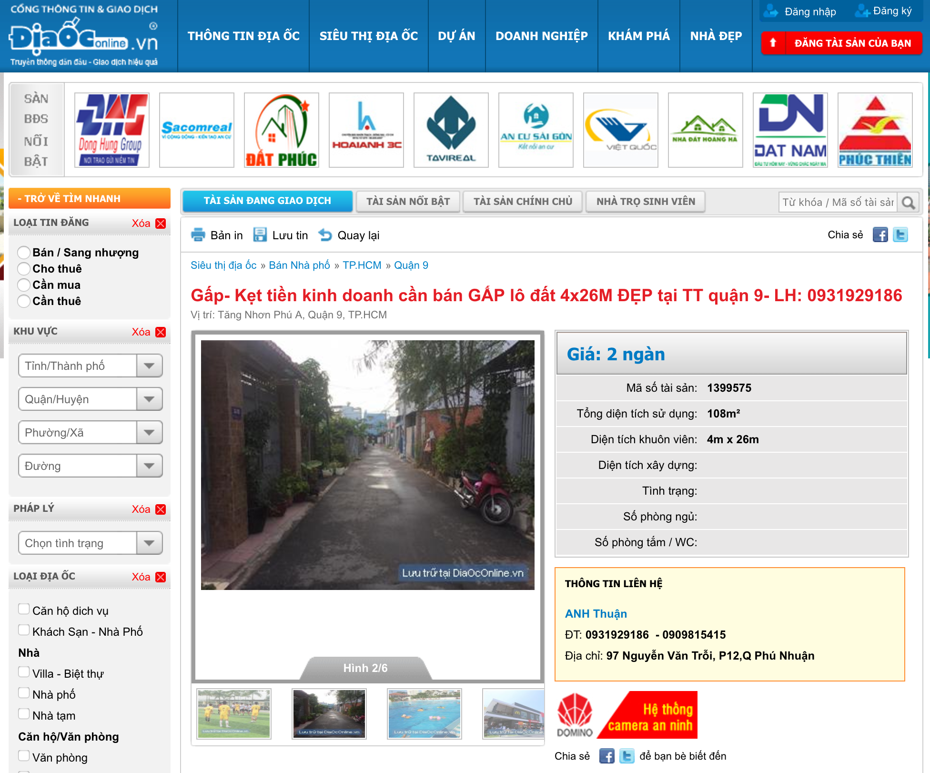
Data Cleaning
Unreasonable Value Removal

Slide 20
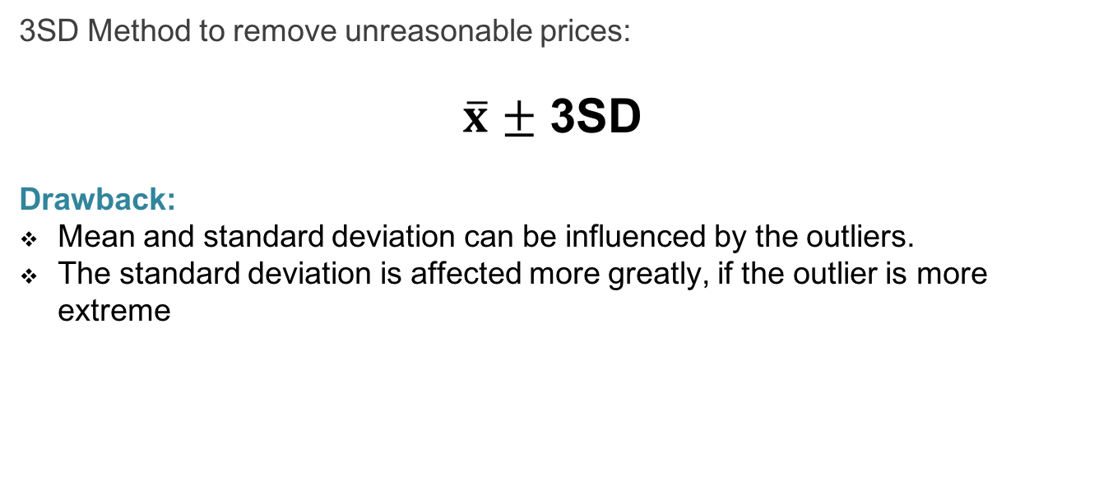
Standard Deviation
3SD Method to remove unreasonable prices:
$\overline{x}$ $±$ 3SD
Drawback:
Mean and standard deviation can be influenced by the outliers.
The standard deviation is affected more greatly, if the outlier is more extreme

Slide 21
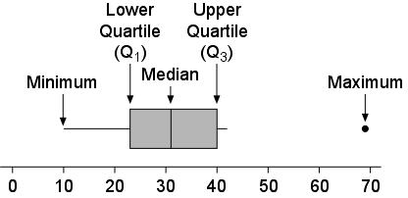
Interquartile Range
Interquartile Range is computed as:
IQR = Q3 – Q1
Outliers are detedted by:
Values below Q1 – 1.5xIQR
Values above Q3 + 1.5xIQR
Drawback:
If Q1 is equal Q3, IQR will be 0
Outliers cannot be detected because width of expected range is 0

Slide 22
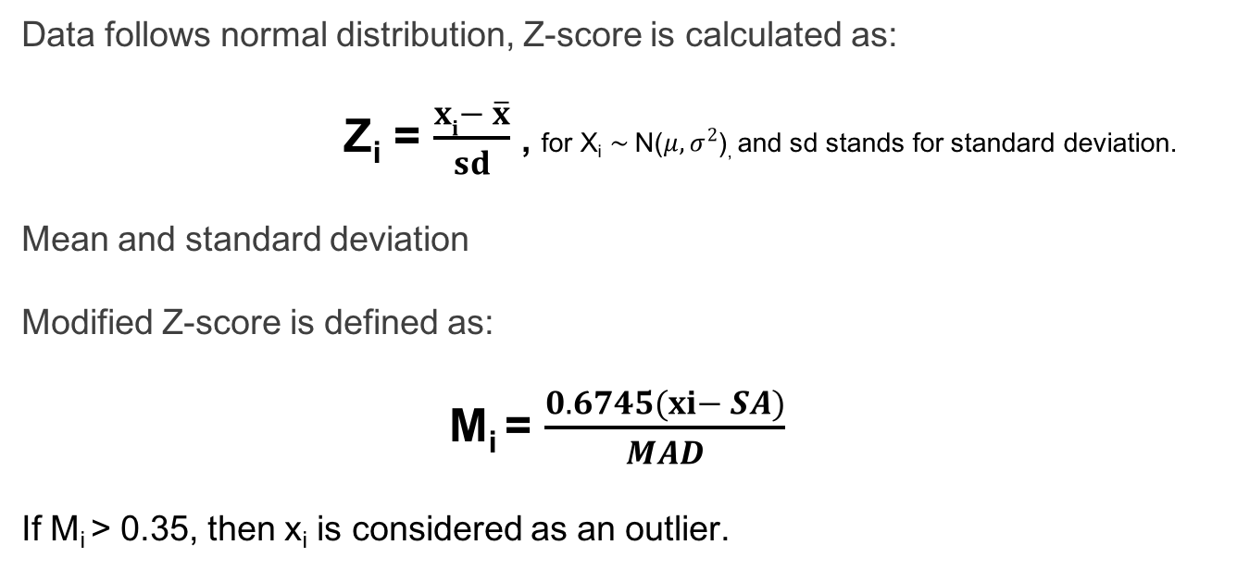
Modified Z-Score
Data follows normal distribution, Z-score is calculated as:
Z_{i} = $\frac{xi− \overline{x}}{sd}$ , for X_{­i} $\sim$N($μ, σ^{2}$), and sd stands for standard deviation.
Mean and standard deviation
Modified Z-score is defined as:
M_{i} = $\frac{0.6745(xi− SA)}{MAD}$
If M_{i} > 0.35, then x_{i} is considered as an outlier.

Slide 23

Result

Slide 24
Conclusion Future Work

Slide 25
Conclusion

Slide 26

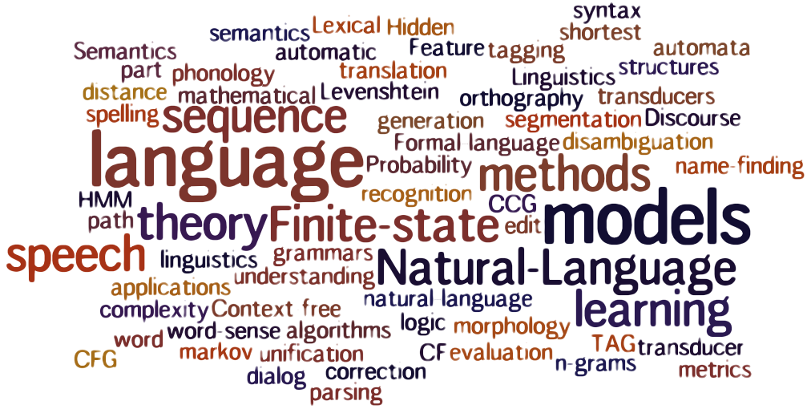

Future Work
Expand the dataset
Apply text mining and natural languale processing to extract other details of a housing listing
Apply machine learning in duplication removal – compare content

